Slide 1


AICTE- Internship on AI: Transformative Learning with TechSaksham – A joint CSR initiative of Microsoft & SAP, focusing on AI Technologies.
Student Name :
Ayush K Shetty
AICTE Internship Student Registration ID *
STU66462c769e5971715874934
AICTE Internship ID
College Name :
Faculty of Engineering and Technology, Jain (Deemed – to – be University)
INTERNSHIP_1736316743677e1747e0671

Slide 2
CAPSTONE PROJECT SHOWCASE
Project Title
AI-powered Resume Screening and Ranking System
Abstract | Problem Statement | Project Overview | Proposed Solution | Technology Used | Modelling & Results | Conclusion

Slide 3
Abstract
1
The AI Resume Screening System is a web app that helps recruiters quickly and fairly screen resumes based on job descriptions.
2
It reads PDF resumes, analyzes them using NLP techniques, and scores them for relevance using TF-IDF and Cosine Similarity. The app is built with Python and Streamlit.
3
The system ranks candidates accurately, showing a list and charts to help recruiters choose the best fits.
It can be upgraded to support more file types and advanced text analysis methods.
4

Slide 4


Problem Statement
The traditional manual resume screening process is time-consuming, inefficient, and often influenced by human bias, making it challenging for recruiters to handle large volumes of applications effectively. Identifying the most suitable candidates based on job requirements demands significant effort and time. This project aims to address these challenges by developing an AI-based system that automates resume screening and candidate ranking using Natural Language Processing (NLP) techniques, ensuring a faster, unbiased, and more accurate recruitment process.

Slide 5

Project Overview
Purpose: Develop an AI-based system to automate resume screening and ranking based on job descriptions.
Key Features: Extracts, analyzes, and ranks resumes efficiently.
Impact: Reduces manual effort, bias, and speeds up recruitment.

Slide 6
Proposed Solution
AI Integration: Leverage NLP techniques like TF-IDF and Cosine Similarity for resume analysis.
Automated Screening: Extract and rank resumes based on relevance to job descriptions.
User-Friendly Interface: Use Streamlit for an intuitive and accessible recruiter dashboard.
Efficient Decision-Making: Provide visual insights and ranked lists for quick candidate selection

Slide 7
Technology used
Natural Language Processing (NLP): Utilized TF-IDF and Cosine Similarity for resume analysis.
Python: Core programming language for backend logic and data processing.
Streamlit: Built an interactive and user-friendly web interface.
Data Visualization: Employed Matplotlib and Seaborn for displaying ranking results.

Slide 8
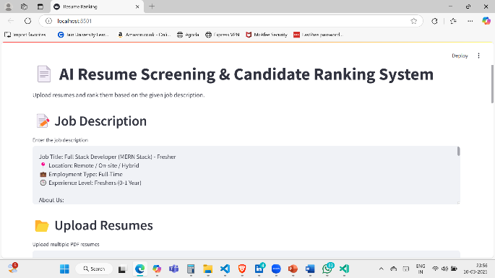
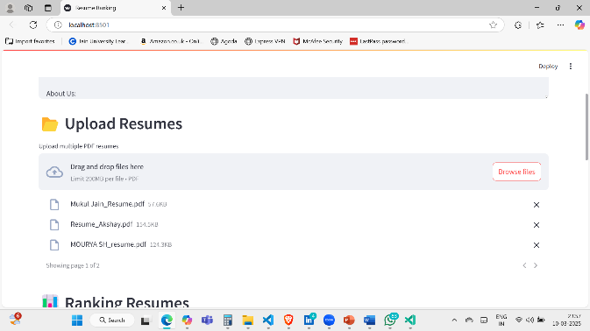
Modelling
The AI Resume Screening System uses TF-IDF to transform resume and job description text into numerical vectors and Cosine Similarity to measure relevance. Text is extracted from PDF resumes using PyPDF2 and preprocessed with tokenization and normalization. The model was built in Python with Scikit-Learn for NLP tasks and Streamlit for the web interface.

Slide 9
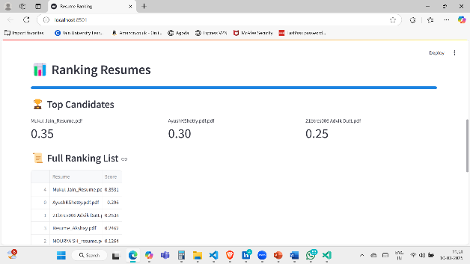
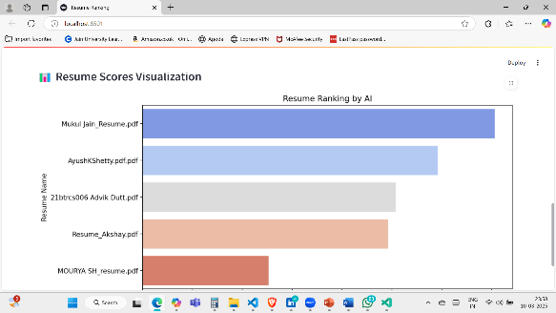
Result
The system efficiently ranked resumes based on relevance scores, presenting results through clear bar charts and ranked lists using Matplotlib and Seaborn. This automated approach minimized manual screening time, enhanced accuracy, and provided unbiased candidate selection insights.

Slide 10

Conclusion
The AI-based Resume Screening and Candidate Ranking System automates resume evaluation using NLP and machine learning techniques to extract skills, education, and experience, matching them with job requirements. It assigns objective scores to candidates, helping recruiters prioritize applicants efficiently. The user-friendly interface simplifies uploading resumes, viewing rankings, and analyzing results, reducing manual effort and minimizing biases. The scalable design allows for future enhancements like real-time feedback, multilingual support, and integration with ATS systems. In conclusion, the system offers a robust, unbiased solution that significantly improves the efficiency and fairness of the recruitment process.

Slide 11


Notes:
Thank You !!

